Slide 1
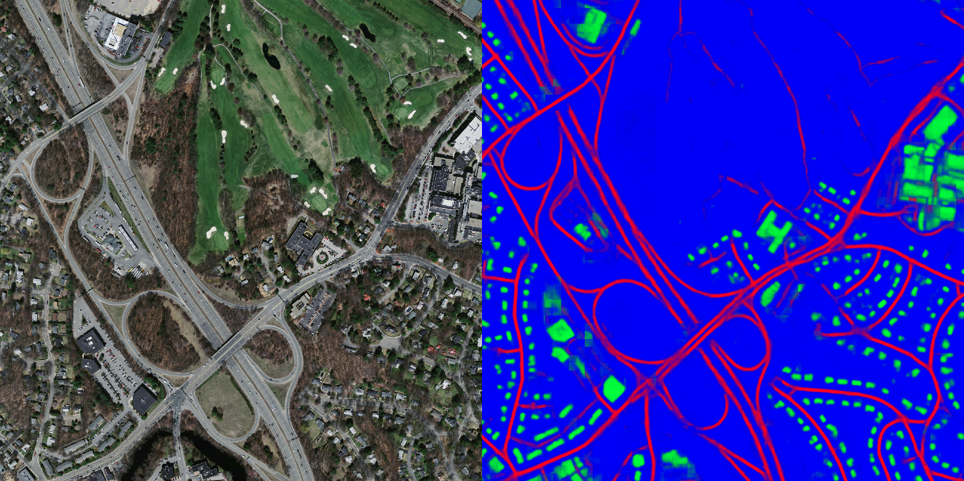
CNN example
From test set:

Slide 2
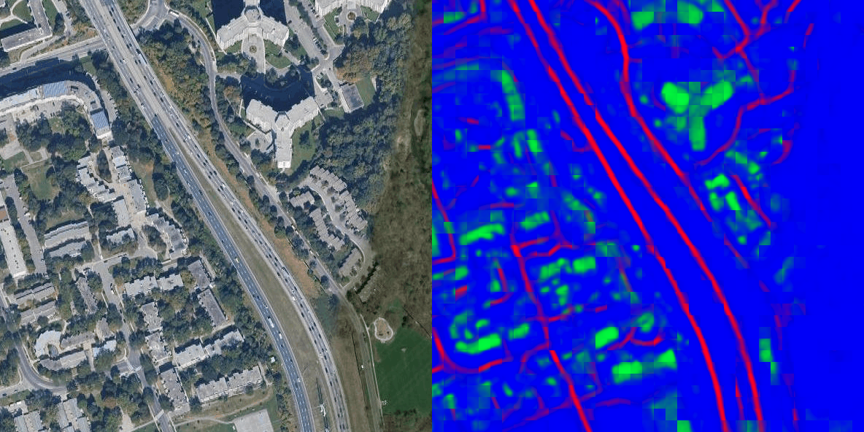
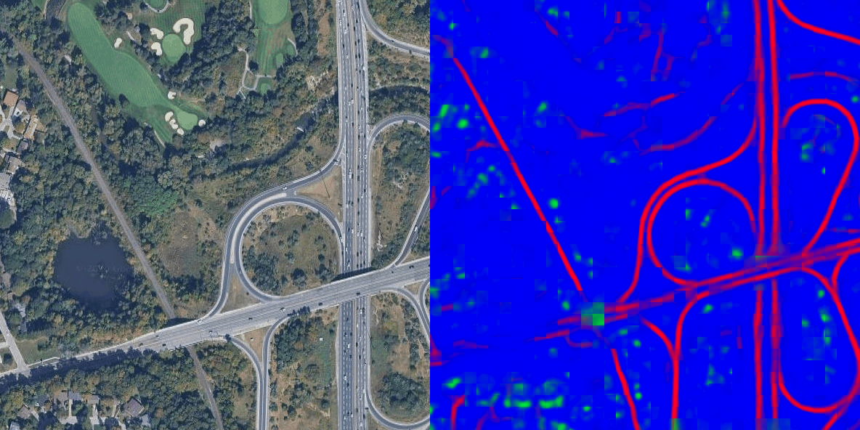
tests our images
Best:
Road conditions are similar to the example (i.e. Massachusetts roads)
Clear
Distinguished from surroundings

Slide 3
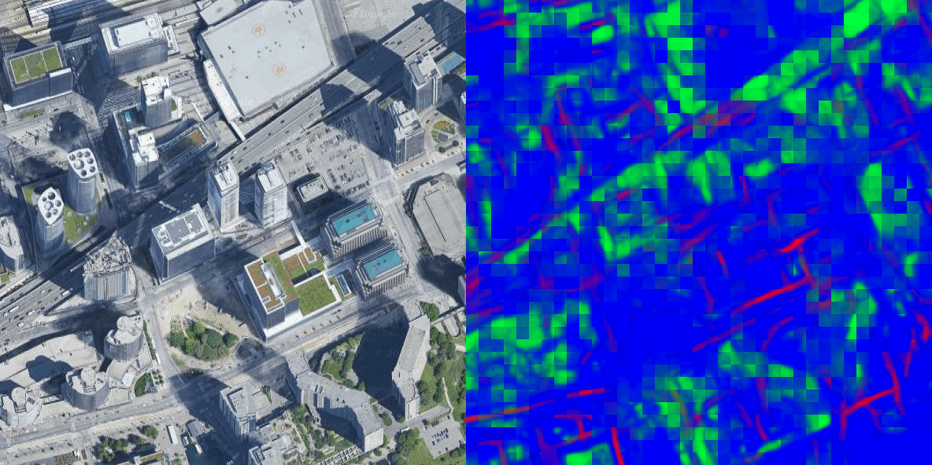
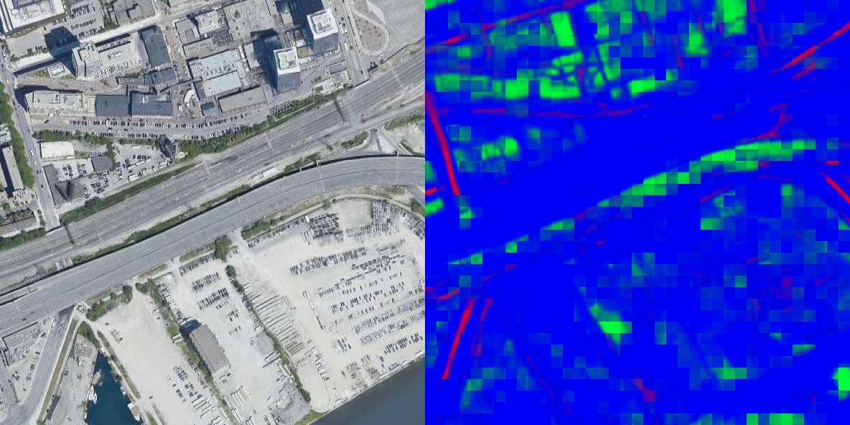
tests our images
v
Worst:
Noise
Improve?
Build own training set
Different road types
Build segmentation masks
Next?
Use mathematical methods to calculate road length and width
Filter out off-road and parked vehicles

Slide 4
Literature review
2019 Kaack et al.
Counting trucks from Satellite images
Fast-RCNN / SSD
Geospatial method (Shapefile)
Road length
Filter out parked trucks (assumption: 4-lane highway)
Estimate AADTT (Annual Average Daily Truck Traffic)

Slide 5
Literature review
2017 Fu et al.
2002 McCord et el.
Counting vehicles from Satellite images
Ignore parked cars
Covered all road types
Manually distinguish parked cars
Estimate AADT

Slide 6
Next step
Models (color filter or CNN)
Filter the roads based on shapefile data
Count the moving vehicles

